Slide 1
Z1146 - ENTREPRENEURSHIP II
SESSION VIII
FINANCE

Slide 2
Learning Objectives
LO 1 : Creating an innovative business model
LO 2 : Generate business strategies to make a sustainable business

Slide 3
Overview

Slide 4
Overview
Revenue is the income earned by a business over a period of time, e.g. one month
revenue = price x quantity
Revenue is sometimes called sales, sales revenue, total revenue or turnover.
Costs are the expenses involved in making a product. Firms incur costs by trading.

Slide 5
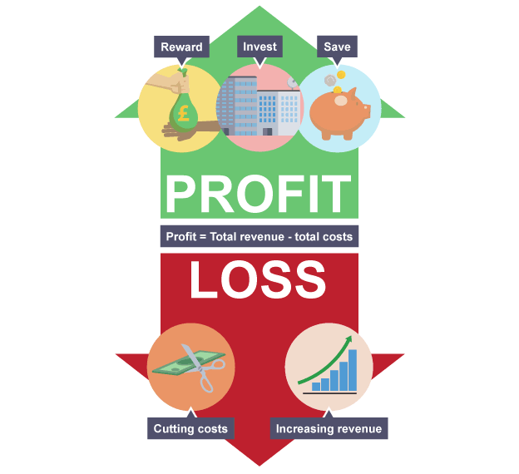
Overview
https://www.bbc.co.uk/education/guides/zxq2hyc/revision/2

Slide 6
Overview
Profit is the surplus left from revenue after paying all costs.
profit = total revenue - total costs
A business can use profit to either:
reward owners
invest in growth
save for the future, in case there is a downturn in revenue

Slide 7
Overview
A loss is made when the revenue from sales is not enough to cover all the costs of production.
Losses can be reduced or turned into profit by:
cutting costs - e.g. by letting staff go and asking those who remain to accept lower wages
increasing revenue - e.g. by cutting prices and selling more items - if demand is elastic

Slide 8
Fixed Costs Vs Variable Costs

Slide 9
Fixed Costs Vs Variable Costs
All the costs faced by companies can be broken into two main categories:
Fixed Costs
Costs that are independent of output
Variable Costs
Costs that vary with output
These remain constant throughout the relevant range and are usually considered sunk for the relevant range
Fixed costs often include rent, buildings, machinery, etc.
Generally variable costs increase at a constant rate relative to labor and capital
Variable costs may include wages, utilities, materials used in production, etc.

Slide 10
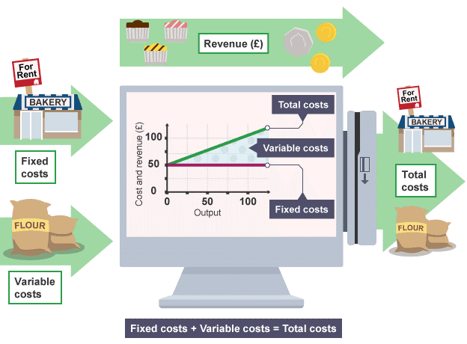
Fixed Costs Vs Variable Costs
https://www.bbc.co.uk/education/guides/zxq2hyc/revision/1

Slide 11
Break Even Point

Slide 12
Break Even Point
The break-even point refers to the revenues needed to cover a company's total amount of fixed and variable expenses during a specified period of time.
The revenues could be stated in dollars (or other currencies), in units, hours of services provided, etc.

Slide 13
Break Even Point
To compute a company's breakeven point in sales volume, you need to know the values of three variables:
Fixed costs: Costs that are independent of sales volume, such as rent
Variable costs: Costs that are dependent on sales volume, such as the cost of manufacturing the product
Selling price of the product

Slide 14
Break Even Point
Breakeven Point in Units =
Fixed Costs ÷ (Price - Variable Costs)
As the owner of a small business, you can see that any decision you make about pricing your product, the costs you incur in your business, and sales volume are interrelated. Calculating the breakeven point is just one component of cost-volume-profit analysis, but it's often an essential first step in establishing a sales price-point that ensures a profit.

Slide 15
Total Addressable Market

Slide 16

Total Addressable Market
The Total Addressable Market (TAM) for your beachhead market is the amount of annual revenue, expressed in dollars per year, your business would earn if you achieved 100 percent market share in that market.
TAM (Aulet, 2013)

Slide 17
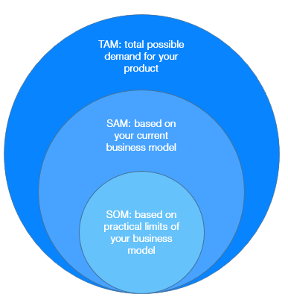
Total Addressable Market
https://theharrisconsultinggroup.com/total-addressable-market/

Slide 18
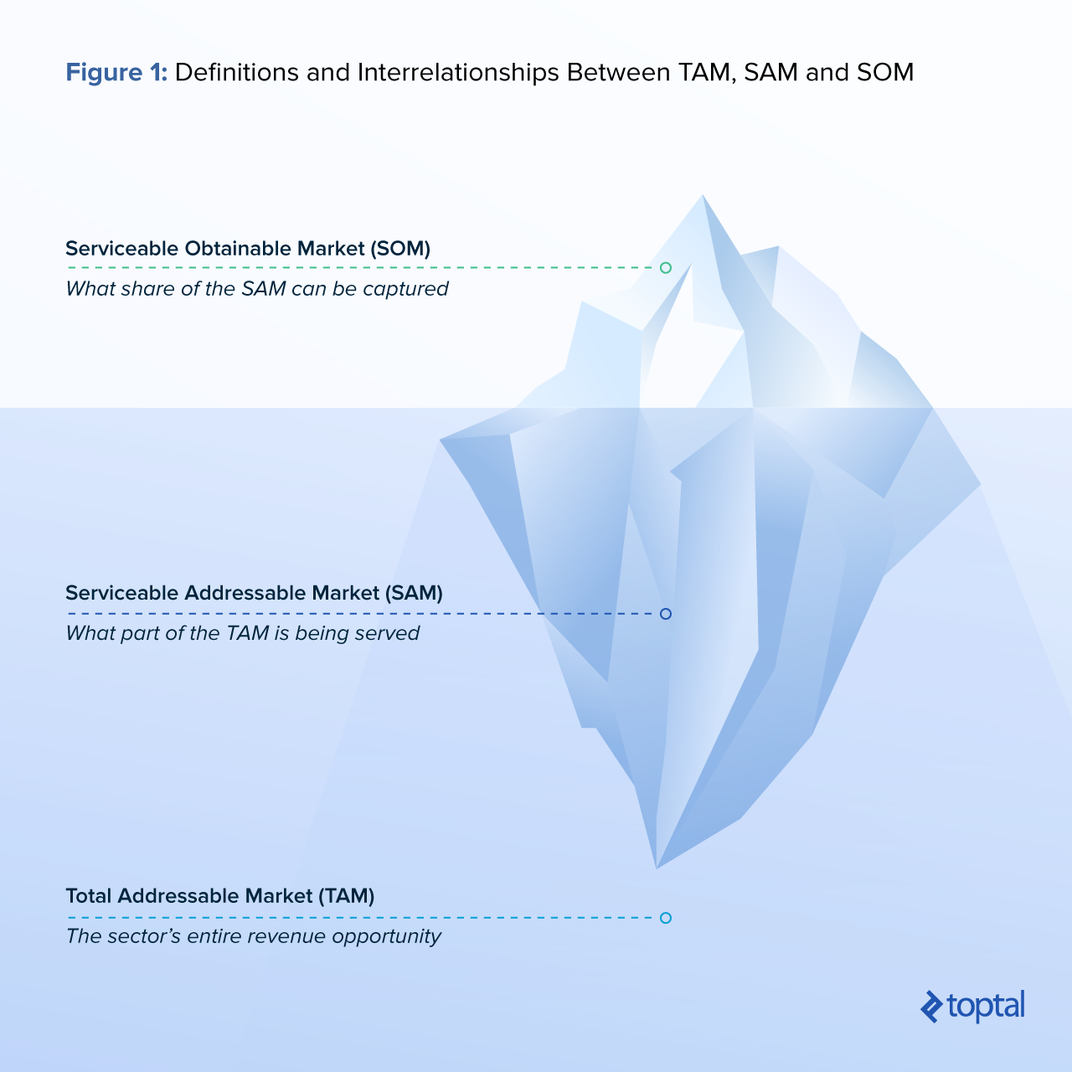
Total Addressable Market
https://www.toptal.com/finance/market-sizing/total-addressable-market-example

Slide 19

Case
Bahaso
https://youtu.be/ME7Z9RcL05I
What are the fixed costs and variable costs of Bahaso?

Slide 20
References
Aulet, B. (2013). Disciplined entrepreneurship: 24 steps to a successful startup. John Wiley & Sons.
Averkamp, H. (n.d.). What is the break-even point? | AccountingCoach. Retrieved December 3, 2017, from https://www.accountingcoach.com/blog/what-is-the-break-even-point
BBC Bitesize - GCSE Business - Revenue, cost and profit - Revision 1. (n.d.). Retrieved December 10, 2017, from https://www.bbc.co.uk/education/guides/zxq2hyc/revision/1
Peavler, R. (2017). Use This Formula to Calculate a Breakeven Point. Retrieved December 10, 2017, from https://www.thebalance.com/how-to-calculate-breakeven-point-393469

